Slide 1


Slide 2
Monday

Slide 3

establishing evidence for the resurrection for the skeptic sbsmelser@comcast.net

Slide 4
1 Peter 3.15
“be ready always to give answer
to every man that asks you
a reason concerning
the hope that lies within you”

Slide 5
John 1:46
Acts 17:11

Slide 6
THE IDENTITY OF JESUS OF NAZARETH
THE CRUCIFIXION
THE WITNESSES
THE CONV. OF SAUL
THEY BELIEVED
THE TOMB
ESTABLISHING BASIC FACTS
FOR THE SKEPTIC

Slide 7
three observations regarding the gospel & unbelievers
1. cf.: 2013ad > 50ad

Slide 8
When Paul arrived in a city… what percentage of the population
(on average) were unbelievers?
1st
M. J.

Slide 9
three observations regarding the gospel & unbelievers
1. cf.: 2013ad > 50ad
2. est. a base cf. Acts 13 & 17

Slide 10

when teaching unbelievers: back up to a starting point
To a Jewish audience (Ac.13), Paul began where they were.
To a Greek audience (Ac.17), Paul began where they were.
Ac.
17
Ac.
13
“UNKOWN
GOD”
&
CREATION
HEBREW
SCRIPTURE
&
HISTORY

Slide 11
three observations regarding the gospel & unbelievers
1. cf.: 2013ad > 50ad
2. est. a base cf. Acts 13 & 17
3. evidence & faith Lk. 5

Slide 12
Jesus taught an evidence based faith
John 5:31 & ff

Slide 13
evidence based faith: JOHN 5:31-39
inner identity
unseen
witness of
John
witness of works
witness of proph.
seen

Slide 14
a reminder:
FEELINGS
(one way or the other)
DON’T CREATE FACTS:
GEN. 37 LUKE 22

Slide 15
Let me tell you about my dog…

Slide 16
evidence based faith: LUKE 5:24
authority to forgive
the paralyzed man’s sin
unseen
authority to say
“rise and walk” to
the paralyzed man
seen

Slide 17
reasoning from the seen to the unseen :
JURORS BUSINESS MARRIAGE
unseen
seen
UNSEEN
SEEN
UNSEEN
SEEN
UNSEEN
SEEN
Prov. 7 Prov. 31

Slide 18
faith & evidence: an analogy
For those like Thomas, who demand walking fully by sight, rather than needing to have faith, stop and realize how essential faith is in other aspects of our lives as well.
Consider marriage. In Proverbs 7, a man is married to an adulterous. When he leaves home for a journey, she betrays him. In chapter 31, a wiser man has married a worthy woman (Prov. 31). The heart of this husband "trusts" in his wife (ie., has faith in her). Why? Not because he can see her when he's away, for he cannot. He can have faith in what he can't see, based on what he has seen: that she does him good, and not evil, and that she is a woman that fears God. Faith is an essential part of life, both spiritual and family-wise.
We all believe in things & people, that we cannot see right now. That is not irrational, but rational, when there is sufficient basis for faith.

Slide 19
establishing evidence for the resurrection for the skeptic sbsmelser@comcast.net

Slide 20
THE CRUCIFIXION
THE WITNESSES
THE CONV. OF SAUL
THEY BELIEVED
THE TOMB
ESTABLISHING BASIC FACTS
FOR THE SKEPTIC

Slide 21
Secular history & Biblical History
Rom.
10:17

Slide 22
FACT 1. Jesus of Nazareth, known also as the Christ, was put to death by crucifixion during the reign of Tiberius, at the orders of Pontius Pilate.
Historical attestation is found in Christian, Roman, Greek, and Jewish sources.
New Testament Documents:
The primary historical documents for
Jesus of Nazareth are of course
the NT texts, whose very origin and existence
would be inexplicable otherwise.
ROMAN: Tacitus, Annals XV, 44
(Roman senator and historian; b. ca. 56 AD)
“Nero … inflicted the most exquisite tortures on a class … called Christians by the populace. Christus, from whom the name had its origin, suffered the extreme penalty during the reign of Tiberius at the hands of one of our procurators, Pontius Pilate” (Barret 15).
GREEK: Lucian of Samosata
The Death of Peregrine, 11-13 (Greek satirist; b. ca. 125 AD)
“The Christians, you know, worship a man
to this day - the distinguished personage
who introduced their novel rites,
and was crucified on that account.”
(Habermas / Licona 49)
GREEK: Lucian of Samosata
The Death of Peregrine, 11-13 (Greek satirist; b. ca. 125 AD)
“it was impressed on them by their original lawgiver that they are all brothers, from the moment that they are converted, and deny the gods of Greece, and worship the crucified sage, and live after his laws.” www.sacred-texts.com/cla/luc/wl4/wl420.htm
JEWISH: Josephus, Antiquities of the Jews, XVIII, 3.3. (Jewish historian, b. 37 AD)
“Pilate, at the suggestion of the principal men amongst us, had condemned him to the cross”
(though some laudatory parts of the text in XVII.3.3
bear the mark of later embellishment, scholars broadly
recognize this part of the text as being original and authentic).
JEWISH: Talmud, Sanhedrin 43
“on the eve of the Passover
Yeshu was hanged”
Yeshu = Joshua /Jesus
(Habermas / Licona 49)
historically referenced:
CHRISTIAN
ROMAN
GREEK
JEWISH

Slide 23
THE CRUCIFIXION
THE WITNESSES
THE CONV. OF SAUL
THEY BELIEVED
THE TOMB
ESTABLISHING BASIC FACTS
FOR THE SKEPTIC

Slide 24
Acts
5:36-37

Slide 25
THE IDENTITY OF JESUS OF NAZARETH
THE CRUCIFIXION
THE WITNESSES
THE CONV. OF SAUL
THEY BELIEVED
THE TOMB
ESTABLISHING BASIC FACTS
FOR THE SKEPTIC

Slide 27
Tuesday

Slide 28
establishing evidence for the resurrection of Jesus

Slide 29
THE IDENTITY OF JESUS OF NAZARETH
THE CRUCIFIXION
THE WITNESSES
THE CONV. OF SAUL
THEY BELIEVED
THE TOMB
ESTABLISHING BASIC FACTS
FOR THE SKEPTIC

Slide 30
FACT 1. Jesus of Nazareth, known also as the Christ, was put to death by crucifixion during the reign of Tiberius, at the orders of Pontius Pilate.
Historical attestation is found in Christian, Roman, Greek, and Jewish sources.
New Testament Documents:
The primary historical documents for
Jesus of Nazareth are of course
the NT texts, whose very origin and existence
would be inexplicable otherwise.
ROMAN: Tacitus, Annals XV, 44
(Roman senator and historian; b. ca. 56 AD)
“Nero … inflicted the most exquisite tortures on a class … called Christians by the populace. Christus, from whom the name had its origin, suffered the extreme penalty during the reign of Tiberius at the hands of one of our procurators, Pontius Pilate” (Barret 15).
GREEK: Lucian of Samosata
The Death of Peregrine, 11-13 (Greek satirist; b. ca. 125 AD)
“The Christians, you know, worship a man
to this day - the distinguished personage
who introduced their novel rites,
and was crucified on that account.”
(Habermas / Licona 49)
GREEK: Lucian of Samosata
The Death of Peregrine, 11-13 (Greek satirist; b. ca. 125 AD)
“it was impressed on them by their original lawgiver that they are all brothers, from the moment that they are converted, and deny the gods of Greece, and worship the crucified sage, and live after his laws.” www.sacred-texts.com/cla/luc/wl4/wl420.htm
JEWISH: Josephus, Antiquities of the Jews, XVIII, 3.3. (Jewish historian, b. 37 AD)
“Pilate, at the suggestion of the principal men amongst us, had condemned him to the cross”
(though some laudatory parts of the text in XVII.3.3
bear the mark of later embellishment, scholars broadly
recognize this part of the text as being original and authentic).
JEWISH: Talmud, Sanhedrin 43
“on the eve of the Passover
Yeshu was hanged”
Yeshu = Joshua /Jesus
(Habermas / Licona 49)
historically referenced:
CHRISTIAN
ROMAN
GREEK
JEWISH

Slide 31
THE CRUCIFIXION
THE WITNESSES
THE CONV. OF SAUL
THEY BELIEVED
THE TOMB
ESTABLISHING BASIC FACTS
FOR THE SKEPTIC

Slide 32
Jerusalem, circa 30 ad
Luke 23. 33-56

Slide 33
Jesus was not just dead, not just killed…
Jesus was crucified.
Beyond death & torture :
what was the purpose of public crucifixion ?
degradation & shame
horror & intimidation

Slide 34
crucifixion & roman subjects
“Whenever we crucify the guilty, the most crowded roads are chosen, where most people can see and be moved by this fear. For penalties relate not so much to retribution, but to their exemplary effect.” – Quintilian Decl. 274 (trans. From LCL 500) -cited in Baker & Green; Recovering the Scandal of the Cross IVPress 2000
“the executioner… and the very word ‘cross,’ let them all be far removed from not only the bodies of Roman citizens but even from their thoughts, their eyes, and their ears… the mere mention of them are unworthy of a Roman citizen and a free man.” -Cicero , pro Rabirio Perd. 16 perseus.uchicago.edu/perseuscgi/citequery3.pl?dbname=PerseusLatinTexts&getid=1&query=Cic.%20Rab.%20Perd.%2019
crucifixion & roman citizens

Slide 35
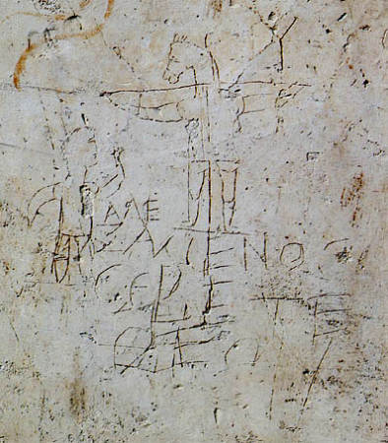
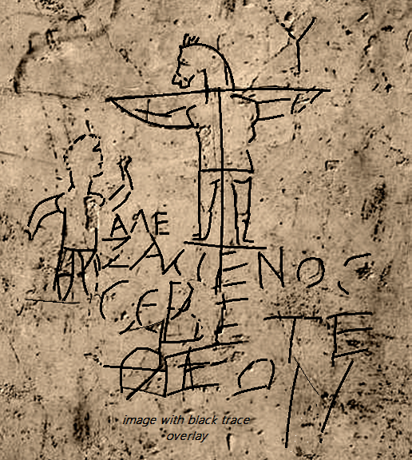
“we preach Christ crucified,
to Jews a stumbling block and to Gentiles foolishness”
1 Cor. 1.23 NASB
ΑΛΕ
ΞΑΜΕΝΟS
CΕΒΕΤΕ ΘΕΟΝ
“ALEXAMENOS WORSHIP(S) HIS GOD”
alexamenos graffito public domain image; wikipedia

Slide 36
Lk.23:55-56
“the women… beheld the tomb, and how his body was laid. And they returned, and prepared spices and ointments.
And on the sabbath, they rested according to the commandment.
But on the first day of the week, at early dawn, they came unto the tomb, bringing the spices which they had prepared…”
if they
had found
what they expected
to find …

Slide 37
They would have anointed a corpse
Peter and John would not have run to see the empty tomb
The body would have decayed to dust
You would never have heard of Jesus of Nazareth
You would not be a Christian
You would not be here today
Sunday would not be a day of worship
You would never have known anyone named Peter
The first book ever printed would not have been printed
The best selling book of all time would never have existed
The pilgrims would not have sailed on the Mayflower
The coins in you pocket would not bear their dates
If your p / gr-p / etc. met at church, you would not exist

Slide 38
cf. Acts 5.36-37

Slide 39
THE IDENTITY OF JESUS OF NAZARETH
THE CRUCIFIXION
THE WITNESSES
THE CONV. OF SAUL
THEY BELIEVED
THE TOMB
ESTABLISHING BASIC FACTS
FOR THE SKEPTIC

Slide 40
John
19:38-20:10

Slide 41
From the apostle John: cf. John 21.18-24 already in circulation by c.125+/- AD;
John Rylands fragment / P52 ( Jn.18 )
ΟΙ ΙΟΥΔΑΙΟΙ ΗΜΕIΝ ΟΥΚ ΕΞΕΣΤΙΝ ΑΠΟΚΤΕΙΝΑΙ
OYΔΕΝΑ ΙΝΑ Ο ΛΟΓΟΣ ΤΟΥ ΙΗΣΟΥ ΠΛΗΡΩΘΗ ΟΝ ΕΙ-
ΠΕΝ ΣHΜΑΙΝΩΝ ΠΟΙΩ ΘΑΝΑΤΩ ΗΜΕΛΛΕΝ ΑΠΟ-
ΘΝHΣΚΕΙΝ ΙΣΗΛΘΕΝ ΟΥΝ ΠΑΛΙΝ ΕΙΣ ΤΟ ΠΡΑΙΤΩ-
ΡΙΟΝ Ο ΠIΛΑΤΟΣ ΚΑΙ ΕΦΩΝΗΣΕΝ ΤΟΝ ΙΗΣΟΥΝ
ΚΑΙ ΕΙΠΕΝ ΑΥΤΩ ΣΥ ΕΙ O ΒΑΣΙΛΕΥΣ ΤΩΝ ΙΟΥ-
ΔAΙΩN
ΒΑΣΙΛΕΥΣ ΕΙΜΙ ΕΓΩ ΕΙΣ TOΥΤΟ ΓΕΓΕΝΝΗΜΑΙ
ΚΑΙ (ΕΙΣ ΤΟΥΤΟ) ΕΛΗΛΥΘΑ ΕΙΣ ΤΟΝ ΚΟΣΜΟΝ ΙΝΑ ΜΑΡΤY-
ΡΗΣΩ ΤΗ ΑΛΗΘΕΙΑ ΠΑΣ Ο ΩΝ EΚ ΤΗΣ ΑΛΗΘΕI-
ΑΣ ΑΚΟΥΕΙ ΜΟΥ ΤΗΣ ΦΩΝΗΣ ΛΕΓΕΙ ΑΥΤΩ
Ο ΠΙΛΑΤΟΣ ΤΙ ΕΣΤΙΝ ΑΛΗΘΕΙΑ ΚAΙ ΤΟΥΤO
ΕΙΠΩΝ ΠΑΛΙΝ ΕΞΗΛΘΕΝ ΠΡΟΣ ΤΟΥΣ ΙΟΥ-
ΔΑΙΟΥΣ ΚΑΙ ΛΕΓΕΙ ΑΥΤΟΙΣ ΕΓΩ ΟΥΔEΜΙΑΝ
ΕΥΡΙΣΚΩ ΕΝ ΑΥΤΩ ΑΙΤΙΑΝ
...
JOHN

Slide 42
“He is not here, he is risen” Mt.28:6 the stone is rolled back… “he is not here, behold, the place where they laid him!” Mk.16:4-6
“they entered in, and found not the body of Jesus” Lk 24:3
“and behold, the linen cloths lying” Jn.20:6

Slide 43
FACT 2. The tomb was reported empty
The disciples reported that the tomb was empty and that Jesus rose from the dead
(Mt. 28; Mk 16; Lk 24; Jn 20)
Unbelieving Jews said the tomb was empty because the disciples stole the body (Mt. 28:15b)
Diametrically opposed as to why the tomb was empty, one point was agreed upon by both explanations: the body was not there.

Slide 44
Matt. 28
… some of the guard came into the city and reported to the chief priests all that had happened…
they gave a large sum of money to the soldiers, and said, "You are to say,
'His disciples came by night and stole Him away while we were asleep. And they took the money and did as they had been instructed;
and this story was widely spread
among the Jews, and is to this day.

Slide 45
objection
skeptic :
“Your claim that the Jews said the body was stolen is based on Matthew. If I don’t trust Matthew on its portrayal of Jesus, why would I trust its portrayal of his opponents?”

Slide 46
skeptic objection: “You can’t use Matthew 28 as a source for what the unbelievers said. As a skeptic, if I don’t accept the gospel accounts of the virgin birth in ch. 1, or the walking on water in ch. 14, why should I accept from from ch. 28 that the Jews said the body was stolen?
reply: Because even from a legendary/propaganda point of view,
the one statement in Mt. 28 that would still fit would be this:
“this story has been SPREAD AMONG THE JEWS TO THIS DAY.” Here’s why:
(A.) With Matthew containing more Old Testament citations than any other gospel, a Jewish audience is indicated.
(B) A Jewish audience of his day (i.e.; the time when the text was written) would obviously be in a good position to know what was (or was not) being claimed among “among the Jews to this day.”
(C.) What would be the point of attributing an opponent’s claim to dishonesty and bribery, if not to undermine a claim that the opponent was actually making?
The stolen body argument is also repeated later in Justin Martyr’s 2nd century Dialogue with Trypho; 108, where the claim that the disciples stole the body by night is again presented as a Jewish argument.

Slide 47
Mt.28.15b nasb
“this story was widely
spread among the
Jews, and is to this day”
original
audience

Slide 48
two further observations on the empty tomb…

Slide 49
(a.) LOCALE:
The church began in Jerusalem, the city of Jesus’ death & burial.
If there had been a demonstrably non-empty tomb,
it would have had a very different effect than
a demonstrably empty tomb.

Slide 50
(b.) Jewish views on female witnesses:
“any evidence which a woman [gives] is not valid...
A robber is qualified to give the same evidence as a woman”
-Talmud, Rosh Hashannah 1.8 (Habermas / Licona 72)
“let not the testimony of women be admitted … it is probable they may not speak the truth, either out of hope of gain, or fear of punishment” -Josephus, Antiquities 4.8.15
If early disciples had made up the story, is it likely that they would make Peter a coward, and make women the first witnesses?

Slide 51

In The Case for the Ressurection of Jesus,
Habermas and Licona lay out a minimal facts case for the resurrection, starting with points that are granted by “virtually all scholars on the subject, even the skeptical ones.” (p.47).
Though the empty tomb is not acknowledged that fully:
“it is accepted as a fact of history by an impressive majority …
Habermas discovered that roughly
75 percent of scholars on the subject accept the empty tomb as historical fact.” (p.70).

Slide 52
an empty tomb does not prove a resurrection
objection

Slide 53

alternate explanations of the empty tomb various other explanations have been offered over the centuries, such as: a.) The tomb was empty because the disciples stole the body b.) The tomb was empty because Jesus was buried alive and recovered c.) The tomb was empty because they mistakenly returned to a different tomb

Slide 54
alternate explanations of the empty tomb various other explanations have been offered over the centuries, such as: a.) The tomb was empty because the disciples stole the body b.) The tomb was empty because Jesus was buried alive and recovered c.) The tomb was empty because they mistakenly returned to a different tomb
According to Habermas &Licona, H.S. Reimarus might be considered the last “well-known critic” to have argued it (publ. p.h. in 1778)
Habermas & Licona, The Case for the Resurrection of Jesus. P.300).
A big problem with this theory is the evidence of the transformed disciples’ conviction; despite beatings, imprisonment and death.
Corpse thieves, by definition, would not be men that believed in the resurrection.
Another issue would be the resurrected appearances. Moving a dead body doesn’t make it appear, converse, eat and drink.
This also apply in the adjusted theory that someone else stole the body.

Slide 55
alternate explanations of the empty tomb various other explanations have been offered over the centuries, such as: a.) The tomb was empty because the disciples stole the body b.) The tomb was empty because Jesus was buried alive and recovered c.) The tomb was empty because they mistakenly returned to a different tomb
scourged (John 19:1)
compelling of Simon (Mark 15:21).
crucified (Mark 15:25).
collapsed and dead (John 19:32-33).
visual clarity of breath or not (v.23).
the spear (John 19:34).
the body was taken down, wrapped, buried, and a large stone was rolled across the door (Mark 15:46).

Slide 56
alternate explanations of the empty tomb various other explanations have been offered over the centuries, such as: a.) The tomb was empty because the disciples stole the body b.) The tomb was empty because Jesus was buried alive and recovered c.) The tomb was empty because they mistakenly returned to a different tomb
the women observed the burial
multiple visitors and at different times (Jn 20:1; Mk 16:2; Jn 20:3-13).
Joseph and Nicodemus (Matt. 27:60)
a dead body in a different tomb does not make appearances

Slide 57
more than an empty tomb…

Slide 58
THE IDENTITY OF JESUS OF NAZARETH
THE CRUCIFIXION
THE WITNESSES
THE CONV. OF SAUL
THEY BELIEVED
THE TOMB
ESTABLISHING BASIC FACTS
FOR THE SKEPTIC

Slide 60
Wednesday

Slide 61
establishing evidence for the resurrection of Jesus

Slide 62
“we gazed not in
the open tomb…”

Slide 63
John 20-21
Acts 10:39-41
1 Cor.15.1-11
eyewitnesses

Slide 64
THE IDENTITY OF JESUS OF NAZARETH
THE CRUCIFIXION
THE WITNESSES
THE CONV. OF SAUL
THEY BELIEVED
THE TOMB
ESTABLISHING BASIC FACTS
FOR THE SKEPTIC

Slide 65
[3.] THE DISCIPLES GAVE WITNESS OF SEEING JESUS ALIVE
John 20 - 21
Acts 2.32;
3.13-15; 10.39-40
1 Cor. 15.1-8

Slide 66
I’ve read that the gospel accounts are legendary and from a later generation.
For what reason should I even believe that the earliest disciples actually even made such claims?
objection

Slide 67
1 Ptr. 3.15
In giving a reason to the skeptic, the witness list in 1 Cor. 15 is a valuable and early starting point.
Clement 95AD
"Take up the letter of Paul... he gave you spiritual direction regarding himself, Cephas, and Apollos, for even then you were dividing yourselves into parties” (ISBE VII.p711)
1 Cor. is one of the letters accepted even by critics
would make no sense as a fabrication
already known & quoted in 1st cent. (Clement)
1 Cor. 15
THE SKEPTIC VIEW
OF THE DOCUMENTS
the gospels

Slide 68
1Cor. 15 provides early & dateable evidence against the
“later legend” concept

Slide 69
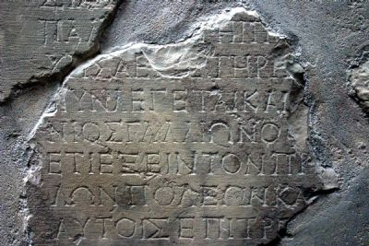
1 Cor. & the Gallio / Delphi inscription
“The inscription dates between April and July A.D., 52, and from it, it can be deduced that Gallio was the proconsul of Achaia in the previous year. Thus Paul’s eighteenth month stay in Corinth (Acts 18:1–18) included the year 51. ”
quotation from, and image courtesy of: www.HolyLandPhotos.org

Slide 70
death & resurrection
15.1ff a reminder of:
20 yr
gap
Date of 1 COR.
B
ca.
30
ca.
50
ca.
55

Slide 71

comparing the time frame:
Think backwards 20 years (early 90’s).
Imagine that a 33 yr. old cult leader had declared himself to be the Son of God.
Imagine he came into conflict with the government.
Imagine he met a violent death.

Slide 72
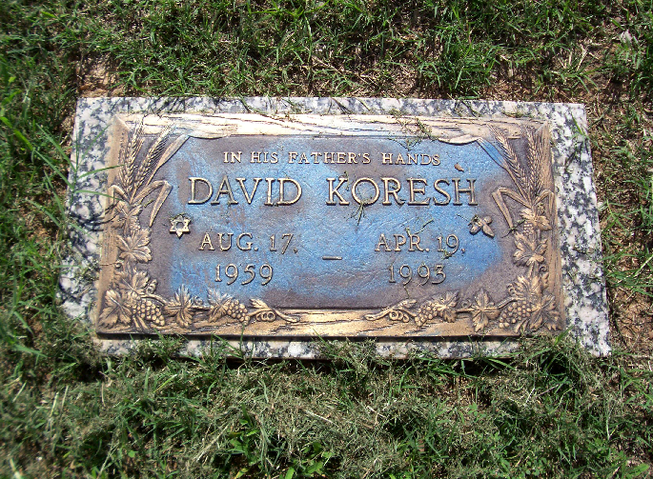
chronology comparison
1959
age 33
1993
ca.20yrs
2013
0
ca. age 33
c.30
ca. 20 yrs
c.50

Slide 73
but we can go back further still:
Galatians 1
( another uncontested letter )
Gal.1:23
“preaching the faith of which he once made havoc.”
In other words, after his conversion (ca. 33-36 AD) he had begun preaching the faith that Peter had been preaching earlier.
This brings us back to a very early date.

Slide 74
death & resurrection
GAL. 1.13-23
15.1ff a reminder of:
20 yr
gap
Date of 1 COR.
B
ca.
30
30’s
ca.
50
ca.
55

Slide 75
1Cor. 15:11
“Whether then it be I or they, so we preach, and so ye believed.”
1 Cor. 15 is not a
later generation legend.
It is a witness list.
The later church did not develop the resurrection,
the early church was built on the resurrection.

Slide 76
THE IDENTITY OF JESUS OF NAZARETH
THE CRUCIFIXION
THE WITNESSES
THE CONV. OF SAUL
THEY BELIEVED
THE TOMB
ESTABLISHING BASIC FACTS
FOR THE SKEPTIC

Slide 77
It was seeing the risen Jesus that transformed the disciples
from fear and despair
to courage and conviction
after his resurrection.
Mk. 14.50-52; Mk. 14.66-72;
Lk.24.21. Jn. 20.19
Ac. 2
Ac. 3
Ac. 4
Ac. 5
Ac. 9

Slide 78
Unbelieving scholars routinely agree that the disciples believed they had seen Jesus. Summing up an overview of more than 1,400 academic sources Habermas reported that :
“perhaps no fact is more widely recognized than that early Christian believers had real experiences that they thought were appearances of the risen Jesus. A critic may claim that what they saw were hallucinations or visions, but he does not deny that they actually experienced something” (p.60).

Slide 79
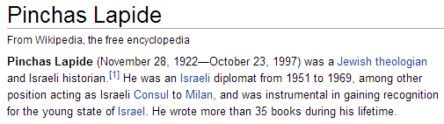
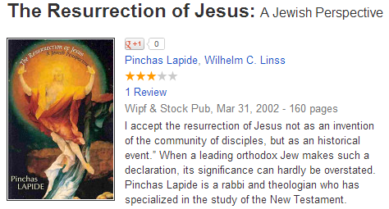
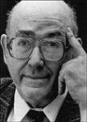
"I accept the resurrection of Jesus not as an invention of the community of disciples, but as an historical event.”
books.google.com/books/about/The_Resurrection_of_Jesus.html?id=1ENrPwAACAAJ

Slide 80
an explosive faith
Acts: 3,000 > 5,000 > multiplied
enemies :
“these that have turned the world upside down” (Acts 17:6) ca. 50 AD “everywhere it is spoken against” (Ac.28:22).
who did Nero choose for a scapegoat?
The phenomenal faith that started in Jerusalem and would out last both Jerusalem and Rome was founded on the disciples’ testimony of Jesus Christ risen from the dead.

Slide 81
faith in Jesus as Lord & risen from the dead
spread across national, cultural & economic lines
the poor & the slaves
(1Cor.1:26; Col.3:22)
Manean, brought up with Herod
(Ac.13:1)
Joannna, the wife of Herod’s steward
(and a witness at the tomb; Luke 24:10 & 8:3)
Erastus, official of the capital of Achaia
(Rom. 16:23)
members of Caesar’s household (Phil. 4:22)

Slide 82
The Apology of Tertullian tr. and annotated by W. Reeve; pp. xvi. 270. [1889.] S
197 AD.
“We are but of yesterday,
and by to-day are grown up, and overspread your empire ;
your cities, your islands, your forts, towns, assemblies,
and your very camps, wards, companies, palace, senate,
Forum… Your temples indeed we leave to yourselves,
and they are the only places
you can name without Christians. ”
www.tertullian.org/articles/reeve_apology.htm

Slide 83
So they believed. What does that prove?
Islamist terrorists believe, and are willing to die.
Does that prove Mohammed a prophet?
Does that prove their 72 virgins?
The jihadist that dies to get 72 virgins is
not a witness. His martyrdom does not demonstrate the validity of
Jihad,
but it does demonstrate his belief in what he has heard
In the case of
Apostolic witnesses,
the case is very different.
They weren’t dying for what they heard.
They died for what they witnessed.
objection

Slide 84
THE IDENTITY OF JESUS OF NAZARETH
THE CRUCIFIXION
THE WITNESSES
THE CONV. OF SAUL
THEY BELIEVED
THE TOMB
ESTABLISHING BASIC FACTS
FOR THE SKEPTIC

Slide 85
[5.] Paul was radically transformed after a reported encounter with Jesus.
Paul’s testimony is powerful and must be either true or false.
If false: he was deceived or lying (options 1 & 2 below).
If true : then Jesus is the risen Christ (option 3 below).
(1.) Paul’s testimony is false, but he was deceived: (a.) by self (b.) by someone else.
(2.) Paul’s testimony is false, and he knew it. He made it up.
(3.) Paul’s testimony is true. Jesus is the risen Christ.
Acts 9
Acts 22
Acts 26
1Cor 15.9
Gal.1.11-17
Php. 3.4-6
1Tim.1.13-16

Slide 86
[5.] Paul was radically transformed after a reported encounter with Jesus.
Paul’s testimony is powerful and must be either true or false.
If false: he was deceived or lying (options 1 & 2 below).
If true : then Jesus is the risen Christ (option 3 below).
(1.) Paul’s testimony is false, but he was deceived: (a.) by self (b.) by someone else.
(2.) Paul’s testimony is false, and he knew it. He made it up.
(3.) Paul’s testimony is true. Jesus is the risen Christ.
Paul’s testimony is powerful and must be either true or false.
If false, he was deceived or lying (options 1 & 2 below).
If true, then Jesus is the risen Christ (option 3 below).
options:
1.) Paul’s testimony is false, but he was deceived:
(a.) by self (b.) by someone else.
2.) Paul was lying. He made it up.
3.) Paul’s testimony is true. Jesus is the Christ.

Slide 87
(1.) He was deceived?
(a.) self-deception? Was Paul hallucinating, overcome by guilt and doubt? Paul was eager to go, and the expedition to Damascus was at his request (Acts 26:9; 9:1-2). Did Paul have a nightmare? It was at midday, and the blinding bright light was seen by the men travelling with him (Acts 2:6:13; 22:6-9).
(b.) deceived by others? Was someone hiding behind a tree, shining a mirror into his eyes? Would they stay on hand to strike Elymas blind (Acts 13)? Were they on hand to make the crippled walk (Acts 14:8-10)? Furthermore, if after going to the trouble of setting Saul up, why not send him to apostles to control him, rather than leaving him independent as he was (Gal. 1,2)? If he was not deceived by self or by others, but his testimony is false, there is one other option.
(2.) He didn’t believe it, he made it up?
For what possible reason would Saul of Tarsus choose a life of pretending to be the very thing he hated? Why choose a life of persecution, and rejection? Why work so hard to make believes in Christ, and why agonize over the fidelity of brethren in Galatia and Corinth? Why give his soul, life, and death to advane the thing he most wanted to see fail? This is incomprehensible.
(3.) He believed it, because Jesus appeared to him.
“then last of all … he appeared to me also” (1 Cor. 15:8) : Jesus is the risen Christ.
Paul’s testimony is either TRUE or FALSE
If false: he was deceived or he was lying (pts. 1 or 2 below).
If true: then Jesus is the risen Christ (pt. 3 below).

Slide 88
WHY?
Why did Saul of Tarsus began proclaiming the very thing he most wanted to destroy?
Why did he give up his acceptance in Judaism for a belief he hated?
Why did he choose to go from persecutor to persecuted?
Why would he devote his life, and sacrifice his liberty and life for what he had utterly opposed?

Slide 89
1 Cor. 9.1
1 Cor. 15.1-11

Slide 90
conclusion
What explanation accounts for these facts?
What is the explanation for the sudden and radical transformation in Saul of Tarsus?
Why was he willing to undergo such hardship?
Why was the tomb reported empty?
Why did the disciples say they saw Jesus?
Why did they believe they saw Jesus?
What transformed them from fear and despair to courage and conviction?
What changed history?
John 20:3-8 Acts 2:32 1 Cor. 15:1-8

Slide 91
JESUS THE RISEN CHRIST
THE CRUCIFIXION
THE WITNESSES
THE CONV. OF SAUL
THEY BELIEVED
THE TOMB
ESTABLISHING BASIC FACTS
FOR THE SKEPTIC

Slide 92
Romans
1.4

Slide 93
1 Peter 3.15
“be ready always to give answer
to every man that asks you
a reason concerning
the hope that lies within you”

Slide 94
post script: two arguments from unbelievers

Slide 95
from: debunkingchristianity.blogspot.com -J. Loftus http://debunkingchristianity.blogspot.com/2011/10/assessing-minimal-facts-approach-of.html
Habermas and Licona ignore the fact that a miraculous resurrection is always going to be more improbable than any improbable speculation about what may have happened instead. ... Unless they can show that our “improbable” explanations are more improbable than a miracle (and they never do), their argument can’t even get off the ground.
REPLY: How did life originate? By Creator ? Or by chance?
The atheist rejects the regeneration of life with a purpose,
but accepts the generation of life from without a purpose.
Which is more inexplicable?
Resurrection is unquestionably remarkable. But for those who see in creation the power of the creator, the question is not whether or not he is powerful enough to raise the dead. (cf.Ac.26:9)
Atheists & theists both believe in remarkable things.
The atheist accepts the generation of life from non-life, w/o design.
The Christian believes in the generation of life by God, and the regeneration of life, with design, with a reason.
WHICH OF THOSE BELIEFS LACKS AN ADEQUATE CAUSE?

Slide 96
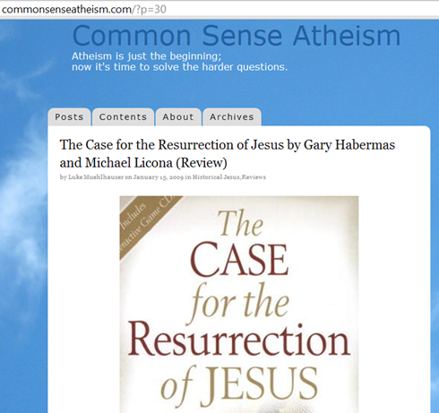
The role of the Resurrection
Believers and skeptics agree: the Christian faith depends on the Resurrection. Paul wrote that “if Christ has not been raised, your faith is futile…” …
But Habermas and Licona want things to work the other way, too. If we have evidence for Jesus’ resurrection, they say, that confirms the truth of Christianity’s claims …
If we have evidence that Jesus rose from the dead, what does that show? That Jesus rose from the dead. And that’s it.
Evidence for the Resurrection would not tell us if Jesus was God or man… Was Jesus even trying to start a religion? These and other questions would remain unanswered by the evidence, even if the resurrection could be proven.

Slide 97
Romans 1.4 declared to be the Son of God by the resurrection from the dead

Slide 98
fini

Slide 99
supplemental charts

Slide 100
bibliography
Barret, C.K. (ed.). The New Testament Background: Selected Documents. New York: Harper, 1961
Buttrick, George (ed.). The Interpreter’s Dictionary of the Bible. Nashville: Abingdon, 1962
Habermas, Gary & Licona, Michael. The Case for the Resurrection of Jesus. Kregel: Grand Rapids MI, 2004
Lapide, Pinchas (tr. Linns). The Resurrection of Jesus: A Jewish Perspective. London: SPCK, 1984
Loftus, John W. "Debunking Christianity: Assessing The Minimal Facts Approach of Habermas, Licona, and Craig." Debunking Christianity: Assessing The Minimal Facts Approach of Habermas, Licona, and Craig. N.p., 15 Oct. 2011. Web. http://debunkingchristianity.blogspot.com/2011/10/assessing-minimal-facts-approach-of.html
Orr, James (ed.). The International Standard Bible Encyclopedia. Grand Rapids: Eerdmans, 1939
Tertullian. The Apology of Tertullian. Trans. William Reeves. London: Griffith Farran, 1889.
William Whiston (tr.) The Works of Flavius Josephus. Grand Rapids: Baker, 1979
Wright, N.T. The Resurrection of the Son of God. Fortress Press: Minneapolis, 2003
E.P. Holding (ed.) Shattering the Christ Myth Xulon Press, 2007

Slide 101
sequence
of events

Slide 102
SUGGESTED CHRONOLOGY OF EVENTS AND APPEARANCES
The following is not presented as exhaustive or inerrant. It is hoped that it will be helpful.
1. Several women (perhaps in different homes), make plans to go, or meet at the tomb, around dawn.
2. Mary Magdalene arrives early “while it is yet dark” (John .20:1). Seeing the tomb open, and before finding out what happened, she runs to report the removal of the body.
3. More women arrive “when the sun is risen” (Mark 16:2). They see the angels and hear the message: “He is not here, but is risen.” They depart.
4. Peter and John arrive, look at the grave clothes, and depart (John 20).
5. Mary returns to the tomb. Weeping, and mistaking a man nearby to be the gardener, she asks about the body. When Jesus calls her by name, she turns and sees it is Jesus.
6. Women report the vision of the angels to the disciples (Luke 24).
7. Jesus appears to the women (Matt. 28:9).
8. Jesus appears to two disciples on the road to Emmaus (Luke 24)
9. They report or affirm an appearance to Simon (Luke 24:34; cf. 1 Cor.15:5).
10. Appears to the disciples, late on that first day of the week (Luke 24:36ff.; John 20:19ff).
11. Appears to the disciples again a week later, with Thomas present (John 20:24ff)
12. Appears to the disciples by the Sea of Galilee (John 21)
13. Appears to more than 500, perhaps in Galilee (Matt. 28:10, 16; 1 Cor.15:6)
14. Appears to his brother James (1 Cor. 15:7).
15. Ascends from the Mt. of Olives (Acts 1; Luke 24)
16. Appears to Saul of Tarsus, on the road to Damascus (1Cor. 15:8; cf. Acts 9; 22; 26)
Note: this sequence does not include textual variants which are not present in all the Mss. (Matt. 28:9a [KJV]; Luke 24:12; and Mark 16:9-20). -S. Smelser

Slide 103
objection
“the text in Josephus
is a later addition”

Slide 104
There are 2 references to Jesus in Josephus :
one where scholars recognize an original reference has been embellished…
and one where scholars widely accept the text as it stands
tr. W.Whitson ccel.org
Antiq.
18.3.3
“Now there was about this time Jesus …
Pilate, at the suggestion of the principal men amongst us, had condemned him to the cross…”
R+ embel.
Antiq.
20.9.1
“Ananus… brought before them
the brother of Jesus, who was called Christ, whose name was James…”
R

Slide 105
Now there was about this time Jesus, a wise man, if it be lawful to call him a man; for he was a doer of wonderful works, a teacher of such men as receive the truth with pleasure. He drew over to him both many of the Jews and many of the Gentiles.
He was [the] Christ.
And when Pilate, at the suggestion of the principal men amongst us, had condemned him to the cross, those that loved him at the first did not forsake him; for he appeared to them alive again the third day; as the divine prophets had foretold these and ten thousand other wonderful things concerning him.
And the tribe of Christians, so named from him, are not extinct at this day.
the embellished text: Josephus Antiq. 18. 3. 3 tr.: Wm. Whitson ccel.org
this text includes statements which would not have come
from Josephus, who was an unbeliever
(next slide)

Slide 106
Josephus was not a believer:
ORIGEN 248ad – Against Celsius 1.47; on A.20.9.1
Josephus “did not accept Jesus as Christ”
DE EXCIDIO HIEROSOLYMITANO 4thc. on A.18.3.3
Josephus “was no believer”
Notice Jerome’s citation of Ant. 18.3.3 [De Viris Illustribus c.13]
“At the same time there was Jesus… followers both of the Jews and of the Gentiles - HE WAS BELIEVED TO BE THE CHRIST.’”
This fits with his wording in Antiq. 20.9.1
“…Jesus, who was called Christ …”
Shattering the Christ Myth, ed. J.P.Holding, 2008, xulonpress, p.23 & 34-35

Slide 107
the word [called] is inserted into the sentence "He was [called] the Christ" on the basis of Josephus's description of James as "the brother of Jesus called the Christ".
About this time there lived Jesus, a wise man...
For he was one who performed paradoxical deeds and was the teacher of such people as accept the truth gladly.
He won over many Jews [and many Greeks?].
He was [called] the Christ. When Pilate, upon hearing him accused by men of the highest standing among us, had condemned him to be crucified, those who had in the first place come to love him did not give up their affection for him...And the tribe of the Christians, so called after him, has still to this day not disappeared.
Antiq. 18.3.3 original as proposed by Geza Vermes
Standpoint Magazine Jan./Feb. 2010 http://standpointmag.co.uk/node/2507/full

Slide 108
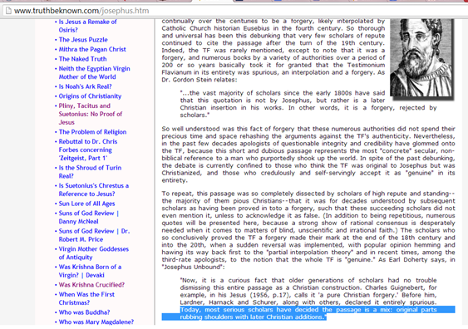
acknowledgment on anti-christian website that treats Christ as a myth:
“Acharya S.” citing Earl Doherty
Acharya S. website, citing Earl Doherty in “Josephus Unbound”
[both Christ-mythers ] www.truthbeknown.com/josephus.htm

Slide 109
very important pt. on core of 18.3 being orig.:
Antiq. 18.3.3
“Now there was about this time Jesus
…He was (prop.reading: called) the Christ… Pilate… condemned him to the cross…”
That makes perfect sense w/ a previous intro. to Jesus being back in Antiq. 18
Antiq. 20.9.1
“Ananus… brought before
them the brother of Jesus,
who was called Christ,
whose name was James…”
NOTE : the accepted ref. in 20 introduces James, not Jesus. Jesus is a ref. to identify James

Slide 110

for further details see chapter in Shattering the Christ Myth edited by J.P. Holding

Slide 111
objection
“non literal genre”
“common motif of dying and rising gods”

Slide 112
Non-literal genre:
Some would propose that the resurrection accounts be read metaphorically and non literally, as one might read the parables. This may describe a liberal clergyman’s Easter sermon, but it is pure nonsense to read Paul in 1 Cor.15:1-19, or John chapter 20, and then suggest that the texts were not meant to be read historically.
Mythical dying and rising gods:
This view portrays the resurrection as a borrowed pagan myth. Various dying and rising pagan deities were associated with the seasonal cycle of winter and spring, but these were not about actual human beings physically coming back to life after death (Wright 80). According to Habermas and Licona, the revival of Osiris by his wife Isis (in the form of a bird, and for the purpose of procreation with him) is the “only account of a god who survived death that predates Christianity” (91). The tale is thoroughly dissimilar to the resurrection accounts of Jesus of Nazareth.

Slide 113
JESUS THE CHRIST
THE CRUCIFIXION
THE WITNESSES
THEIR CONVICTION
THE TOMB
SAUL OF TARSUS
Christian Roman Greek Jewish
empty:
believers
&
unbelievers
Gospels
Acts
1Cor.15
faced beatings
prison & death
Acts
9,22,26
Gal.1
1Cor 15

Slide 114
FAQ

Slide 115
prophecy & foreshadows
Luke
24.
44-46

Slide 116
MICAH 5:2.
But thou, Bethlehem Ephratah, though thou be little among the thousands of Judah, yet out of thee shall he come forth unto me that is to be ruler in Israel; whose goings forth have been from of old, from everlasting.
ISAIAH 9:6,7
For unto us a child is born, unto us a son is given: and the government shall be upon his shoulder: and his name shall be called Wonderful, Counselor, The mighty God, The everlasting Father, The Prince of Peace… upon the throne of David, and upon his kingdom, to order it, and to establish it with judgment and with justice from henceforth even for ever. The zeal of the LORD of hosts will perform this.

Slide 117
PSALM 22:6-18
I am …a reproach of men, despised of the people…
they shoot out the lip, they shake the head,
Saying, He trusted on the LORD
that he would deliver him:
let him deliver him…
the assembly of the wicked have enclosed me:
they pierced my hands and my feet.
I may tell all my bones:
they look and stare upon me.
They part my garments among them,
and cast lots upon my vesture.
verified in DSS

Slide 118
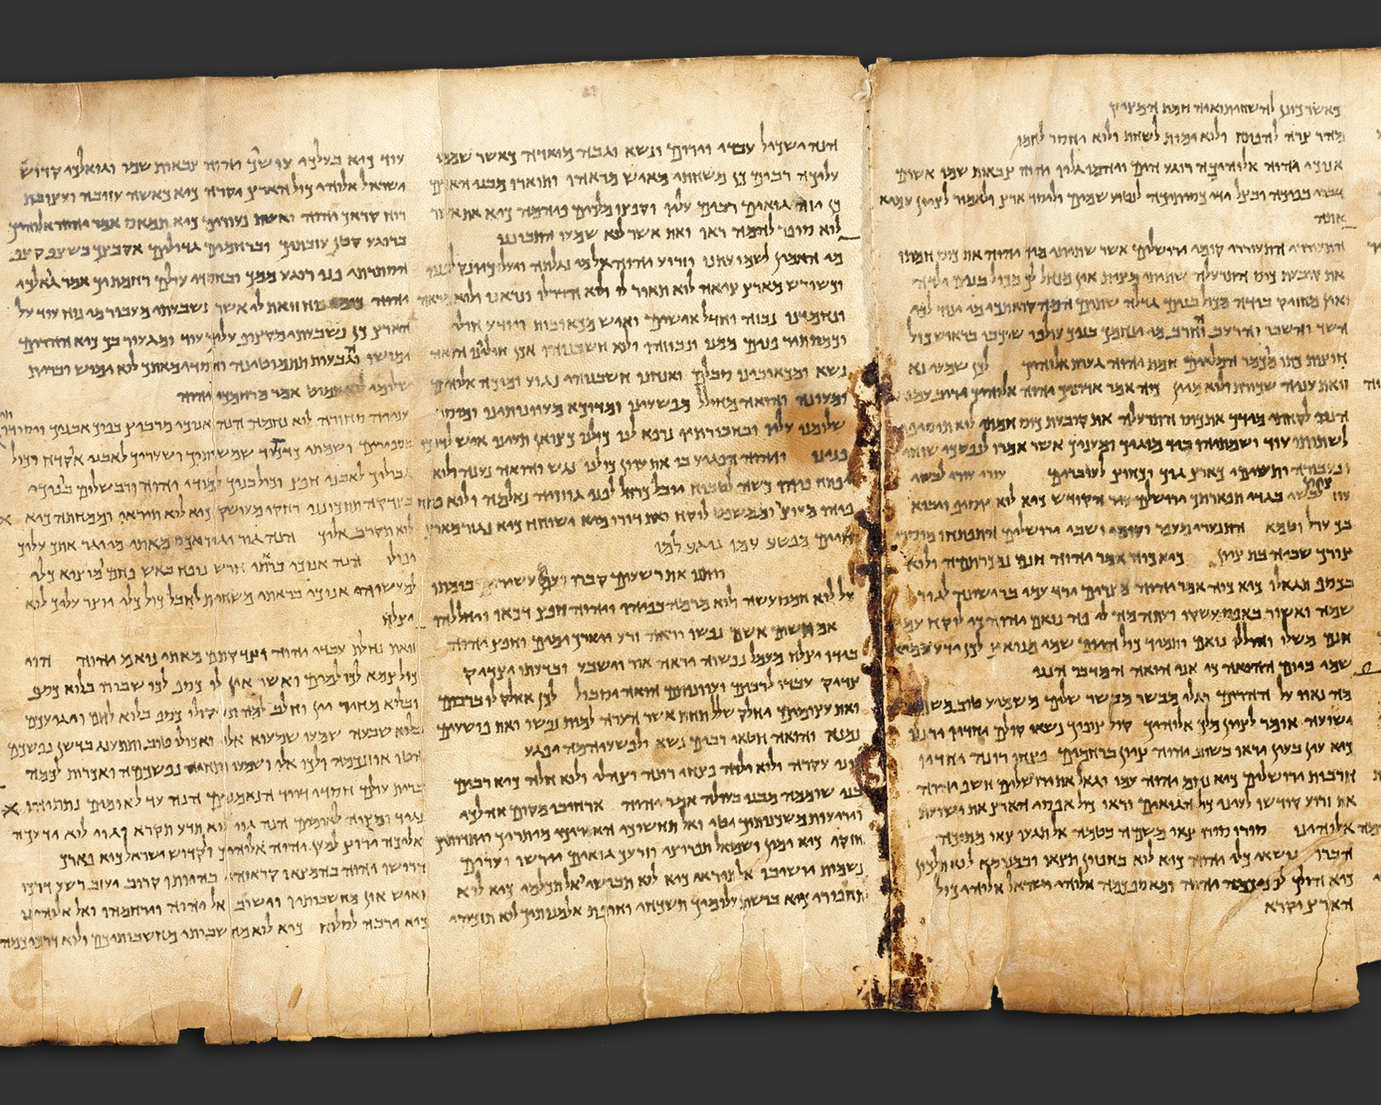
Isaiah 53 ca. 125 B.C. DSS Qumran

Slide 119
Who has believed what we have heard? And to whom has the arm of the LORD been revealed?
For he grew up before him like a young plant, and like a root out of dry ground; he had no form or comeliness that we should look at him, and no beauty that we should desire him.
He was despised and rejected by men; a man of sorrows, and acquainted with grief; and as one from whom men hide their faces he was despised, and we esteemed him not.
Surely he has borne our griefs and carried our sorrows; yet we esteemed him stricken, smitten by God, and afflicted. But he was wounded for our transgressions, he was bruised for our iniquities; upon him was the chastisement that made us whole, and with his stripes we are healed.
All we like sheep have gone astray; we have turned every one to his own way; and the LORD has laid on him the iniquity of us all. He was oppressed, and he was afflicted, yet he opened not his mouth; like a lamb that is led to the slaughter … so he opened not his mouth.
By oppression and judgment he was taken away;
and as for his generation, who considered that
he was cut off out of the land of the living,
stricken for the transgression of my people?
And they made his grave with the wicked and with a rich man in his death, although he had done no violence, and there was no deceit in his mouth.
Yet it was the will of the LORD to bruise him; he has put him to grief; when he makes himself an offering for sin, he shall see his offspring, he shall prolong his days; the will of the LORD shall prosper in his hand;
he shall see the fruit of the travail of his soul and be satisfied; by his knowledge shall the righteous one, my servant,
make many to be accounted righteous;
and he shall bear their iniquities...he bore the sin of many,
and made intercession for the transgressors.

Slide 120
PSALM 16:10
For thou wilt not
leave my soul to Sheol;
Neither wilt thou suffer
thy holy one to see corruption.

Slide 121
“ For the law having a
shadow of good things
to come ” -Heb. 10.1

Slide 122
O.T.
foreshadows
Isaac

Slide 123
Isaac : Jesus
“Take your son, your only son… whom you love”
offer him in sacrifice
Moriah (the only other ref.: 2Chr. 3.1 / Jerusalem)
the son carried the wood
Received him back from death (cf. Heb. 11.19)
“God will provide for himself the lamb.”

Slide 124
O.T. foreshadows
Joseph

Slide 125
Joseph : Jesus
beloved son
sold for silver
rises to right hand of power
desired
to kill him
put into a hole in the ground
meets 1st w/ 10 then w/ all 11
stripped of colorful cloak
mourned as dead
thought dead, seen alive

Slide 126
O.T. foreshadows
Jonah

Slide 127
Jonah : Jesus
light to the gentiles
lives threatened by storm on the sea
asleep in the boat
offers self to save others
calmed the sea
swallowed up and entombed
raised on the third day
Luke 24.44-46; Matt. 12.39-40

Slide 128

Writing and Selling Your Mystery Novel
by Hallie Ephron F&W publ. p. 167

Slide 129
2PETER
1:19
JOHN
5:39
ACTS
3.19-26

Slide 130
sequence
of events

Slide 131
[B.] SUGGESTED CHRONOLOGY OF EVENTS AND APPEARANCES
The following is not presented as exhaustive or inerrant. It is hoped that it will be helpful.
1. Several women (perhaps in different homes), make plans to go, or meet at the tomb, around dawn.
2. Mary Magdalene arrives early “while it is yet dark” (John .20:1). Seeing the tomb open, and before finding out what happened, she runs to report the removal of the body.
3. More women arrive “when the sun is risen” (Mark 16:2). They see the angels and hear the message: “He is not here, but is risen.” They depart.
4. Peter and John arrive, look at the grave clothes, and depart (John 20).
5. Mary returns to the tomb. Weeping, and mistaking a man nearby to be the gardener, she asks about the body. When Jesus calls her by name, she turns and sees it is Jesus.
6. Women report the vision of the angels to the disciples (Luke 24).
7. Jesus appears to the women (Matt. 28:9).
8. Jesus appears to two disciples on the road to Emmaus (Luke 24)
9. They report or affirm an appearance to Simon (Luke 24:34; cf. 1 Cor.15:5).
10. Appears to the disciples, late on that first day of the week (Luke 24:36ff.; John 20:19ff).
11. Appears to the disciples again a week later, with Thomas present (John 20:24ff)
12. Appears to the disciples by the Sea of Galilee (John 21)
13. Appears to more than 500, perhaps in Galilee (Matt. 28:10, 16; 1 Cor.15:6)
14. Appears to his brother James (1 Cor. 15:7).
15. Ascends from the Mt. of Olives (Acts 1; Luke 24)
16. Appears to Saul of Tarsus, on the road to Damascus (1Cor. 15:8; cf. Acts 9; 22; 26)
Note: this sequence does not include textual variants which are not present in all the Mss. (Matt. 28:9a [KJV]; Luke 24:12; and Mark 16:9-20). -s.smelser

Slide 132
the
gospels

Slide 133
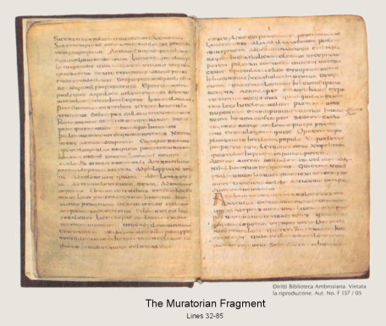
The
Muratorian Fragment:
…the third book of the Gospel is that according to Luke, the well-known physician… the fourth of the Gospels is that of John …of the disciples
www.bible-researcher.com/muratorian.html
Latin copy of orig. from ca. 170 A.D.

Slide 134
a later gospel:
John 3.24; John 11.2 probably late first century: cf. John 21.18-24 already in circulation by c.125+/- AD;
John Rylands fragment / P52 ( Jn.18 )
ΟΙ ΙΟΥΔΑΙΟΙ ΗΜΕIΝ ΟΥΚ ΕΞΕΣΤΙΝ ΑΠΟΚΤΕΙΝΑΙ
OYΔΕΝΑ ΙΝΑ Ο ΛΟΓΟΣ ΤΟΥ ΙΗΣΟΥ ΠΛΗΡΩΘΗ ΟΝ ΕΙ-
ΠΕΝ ΣHΜΑΙΝΩΝ ΠΟΙΩ ΘΑΝΑΤΩ ΗΜΕΛΛΕΝ ΑΠΟ-
ΘΝHΣΚΕΙΝ ΙΣΗΛΘΕΝ ΟΥΝ ΠΑΛΙΝ ΕΙΣ ΤΟ ΠΡΑΙΤΩ-
ΡΙΟΝ Ο ΠIΛΑΤΟΣ ΚΑΙ ΕΦΩΝΗΣΕΝ ΤΟΝ ΙΗΣΟΥΝ
ΚΑΙ ΕΙΠΕΝ ΑΥΤΩ ΣΥ ΕΙ O ΒΑΣΙΛΕΥΣ ΤΩΝ ΙΟΥ-
ΔAΙΩN
ΒΑΣΙΛΕΥΣ ΕΙΜΙ ΕΓΩ ΕΙΣ TOΥΤΟ ΓΕΓΕΝΝΗΜΑΙ
ΚΑΙ (ΕΙΣ ΤΟΥΤΟ) ΕΛΗΛΥΘΑ ΕΙΣ ΤΟΝ ΚΟΣΜΟΝ ΙΝΑ ΜΑΡΤY-
ΡΗΣΩ ΤΗ ΑΛΗΘΕΙΑ ΠΑΣ Ο ΩΝ EΚ ΤΗΣ ΑΛΗΘΕI-
ΑΣ ΑΚΟΥΕΙ ΜΟΥ ΤΗΣ ΦΩΝΗΣ ΛΕΓΕΙ ΑΥΤΩ
Ο ΠΙΛΑΤΟΣ ΤΙ ΕΣΤΙΝ ΑΛΗΘΕΙΑ ΚAΙ ΤΟΥΤO
ΕΙΠΩΝ ΠΑΛΙΝ ΕΞΗΛΘΕΝ ΠΡΟΣ ΤΟΥΣ ΙΟΥ-
ΔΑΙΟΥΣ ΚΑΙ ΛΕΓΕΙ ΑΥΤΟΙΣ ΕΓΩ ΟΥΔEΜΙΑΝ
ΕΥΡΙΣΚΩ ΕΝ ΑΥΤΩ ΑΙΤΙΑΝ
...
JOHN

Slide 135
1. Acts: author involved c.50 ad ~ 62ad.
2. Acts: history abruptly ends ca. 62
3. Luke: has to predate Acts
LUKE
ACTS
10 20 30 40 50 60 70 80 90 100

Slide 136
gnostic
gospels
?

Slide 137
Nag Hammadi Library
4th century papyrus manuscripts
discovered 1945
“Gospel of Thomas,” “Gospel of Phillip,” etc., etc.

Slide 138
some general gnostic traits...
    secret “knowledge”
    many gods
    the creator of this world was evil

Slide 139
Gnostic “gospel of Philip”
Presupposes...
“the Samaritan gave nothing but wine and oil to the wounded man” GOP.78
“That is why the word says, “Already the ax is laid at the root of the trees” GOP.83
The apostles who were before us had these names for him: “Jesus, the Nazorean, Messiah,” GOP.62

Slide 140
Gnostic “gospel of Thomas”
GT quote:
“If you fast, you will give rise to sin for yourselves; and if you pray, you will be condemned; and if you give alms, you will do harm to your spirits” G.T. 14

Slide 141
Gnostic “gospel of Thomas”
JGT parable:
Jesus said, “The kingdom of the [father] is like a certain woman who was carrying a [jar] full of meal. While she was walking [on the] road, still some distance from home, the handle of the jar broke and the meal emptied out behind her [on] the road. She did not realize it; she had noticed no accident. When she reached her house, she set the jar down and found it empty.” G.T. 97

Slide 142
Gnostic “gospel of Thomas”
JMary & the “sacred feminine”? Simon Peter said to them, “Let Mary leave us, for women are not worthy of life.”
Jesus said, “I myself shall lead her in order to make her male, so that she too may become a living spirit resembling you males. For every woman who will make herself male will enter the kingdom of Heaven.”
The Gospel According to Thomas G.T. 114

Slide 143
Gnostic “gospel of Thomas”
JMary & the “sacred feminine”? Simon Peter said to them, “Let Mary leave us, for women are not worthy of life.”
Jesus said, “I myself shall lead her in order to make her male, so that she too may become a living spirit resembling you males. For every woman who will make herself male will enter the kingdom of Heaven.”
-closing lines of G. Acc.to Thomas G.T. 114

Slide 144
Gnostic “apoc. of John”
Contradictions not ltd. to the the gospels: Sheds new knowledge[?] on Genesis as well:
“not as Moses said” again & again. ; eg.:
It is not as Moses said, ‘They hid themsleves in an ark.’ but they hid themselves in a place, not only Noah, but many other people … They went into a place and hid themsleves in a luminous cloud. - Apoc. Of Jn. .29

Slide 145
Gnostic “apoc. of John”
From the intro to Apoc. Of John, by Frederick Wisse The Nag Hammadi Library, J. Robinson, Harper & Rowe
Sophia, consort of the Great Spirit, wanted to reproduce.
She does so w/o consent of her consort.
When she saw … “it changed into a form of a lion-faced serpent … She cast it away from here … that no one of the immortals might see it, for she had created it in ignorance.”
“And she called his name Yaltabaoth.” .10

Slide 146
Gnostic “apoc. of John”
And the multitude of the angels attended him
Eteraphaope-Abron created the head; Meniggesstroeth created the brain; Asterechme the right eye; Thaspomocha the left eye; Jeronumous the right ear; Bissoum the left ear: Akioreim the nose: …
Abitriarm the right underarm, Evanthen the left underarm … [etc. down to the toenails (Miamai)] Ap. of Jn. 17

Slide 147
an angel of the Lord descended from heaven and came and rolled away the stone …
… some of the guard came into the city and reported to the chief priests all that had happened… they gave a large sum of money to the soldiers, and said, "You are to say, 'His disciples came by night and stole Him away while we were asleep. And they took the money and did as they had been instructed;
and this story was widely spread
among the Jews, and is to this day.
assuming a legend / propaganda view
z
rebuttal

